Slide 1
September 11th Fund
Presentation to the Board of United Way of New York City
November 8, 2001

Slide 2
Basic Policy Questions
What range of victims should we support
What kinds of help to fund: cash, services and/or advice?
How much should we duplicate help provided by others, versus “filling in the gaps”?

Slide 3
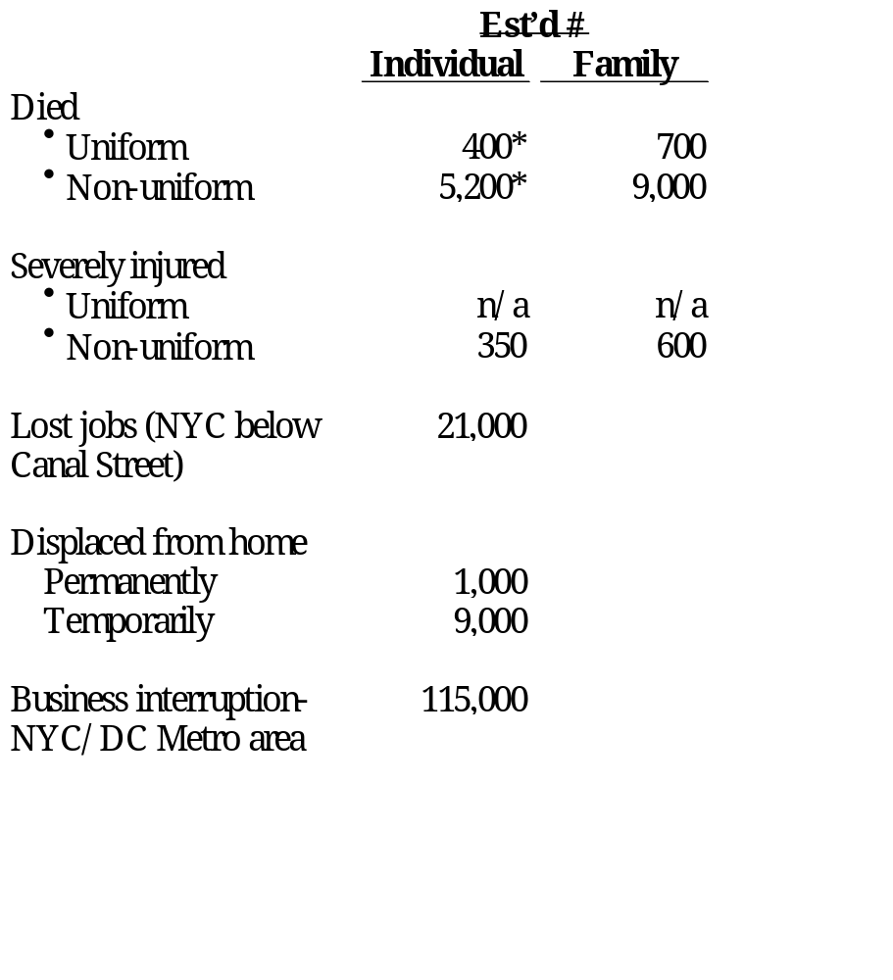
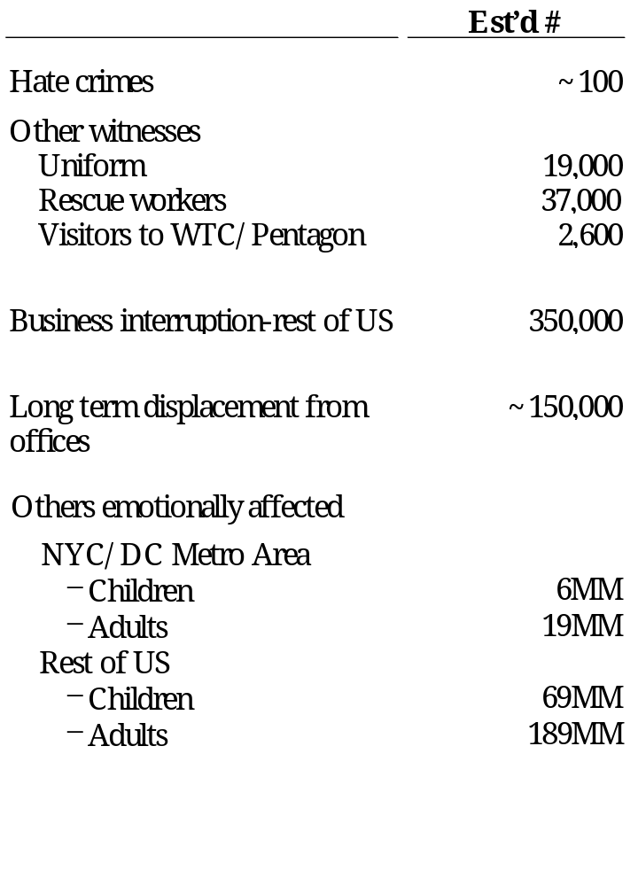
Who’s Affected? Defining “Victim”
* While this reflects Police department estimates, sources continue to look into these figures (e.g. NY Times survey).
Source: CNN; NY Post; Pentagon Public Affairs; FDNY/NYPD Affairs; FEMA; Hevesi report; Fiscal Policy Institute; BPC association; FBI hate crimes statistics; NY Times; McKinsey analysis
Notes:
Victims are not just those who died. They are also those who lost their jobs and were displaced from their homes. Many The (roughly 60,000) rescue workers who survived also sometimes bear the scars of doing so. These figures are rough estimates, gathered by McKinsey from a variety of sources.
Many donors also point to the many nonprofits and small businesses in the area that were devastated, losing their facilities or their clientele.

Slide 4
What Kind of Help? Assistance for Individuals & Families
Immediate relief
Food
Clothing
Shelter
Other pressing necessities
Cash or in-kind donations to victims and families for subsistence needs, including rental/mortgage payments, funeral expenses and other necessities arising from the tragedy
Compensation
Death
Injury
Job loss
Housing loss
Remuneration for losses
Other Aid to Rebuild & Renew
Counseling
Childcare
Legal/financial
services
Scholarships
Training
Healthcare
Community education
Grief counseling and psychotherapy
Child care for those families who lost members or their jobs
Consultations with lawyers and financial planners
Offer of college and K-12 educational assistance
Job placement services and/or retraining
Payment of normal health care costs of victims and families
Information materials and courses to educate and comfort on various topics (e.g., tolerance, anti-violence)

Slide 5
Preliminary Needs & Gap Assessment
Illustrative Classes of Victims
Those who were physically harmed as a result of the attacks on September 11th and their families
Primary
Those experiencing trauma & economic, not physical, harm due to their physical proximity to the WTC/Pentagon
Secondary
All others adversely affected by the events of September 11th
Tertiary
For purposes of analysis only. Other classifications are entirely possible.

Slide 6
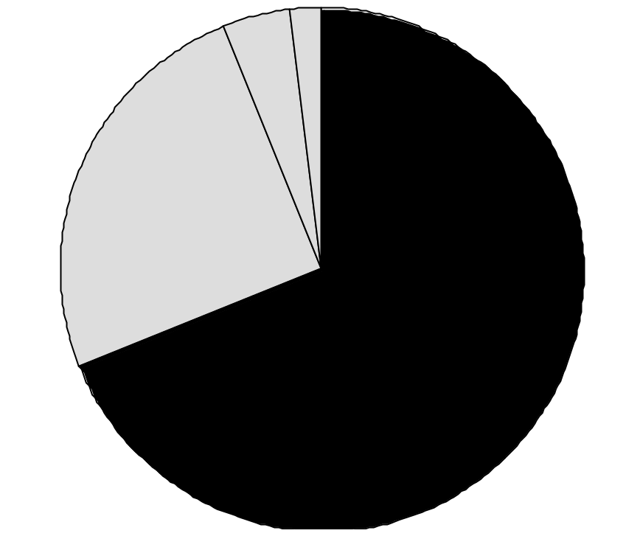
Funds Available for Individuals & Families
Total  $16 Billion (As of October 15) THE SEPTEMBER 11TH FUND IS ONLY ABOUT 2% OF THE TOTAL
Special purpose/restricted
charitable funds, e.g.
Twin Towers Fund: $75 MM (Uniformed Services)
Citigroup Relief Fund: $15 MM (scholarships)
NY Police and Firefighter Widows’ and Children’s Fund: $10M
General purpose
charitable funds, e.g.
Sept 11 Fund: $335M
American Red Cross: $100 MM*
NY Times Neediest Cases Fund: $35 MM
Robin Hood Foundation: $28MM
$200 (1%)
$700 (4%)
$4,000 (25%)
Private insurance***
~$11,000 (70%)
Government funds
and agencies, e.g.
Airline Bill: $6B**
NY State Dept of Labor: $2.6B
Social Security: $1B
Airline recovery portion of gov’t funds: $6,000
* Since 10/15, Red Cross has raised >$500 MM, with $100MM dedicated to cash compensation for Sept 11th relief and $100MM to other direct relief.
** The airline bill is $15 B, $5B in cash to the airlines and $10 in loan guarantees. It is expected that out of that $15B, each family of a deceased or severely injured victim will receive approximately $1MM. Therefore, we estimate that the airline bill portion dedicated to victims is $6B.
***Based on average of estimates provided by the American Council of Life Insurers & the NYC Comptroller’s Report
Source: Robin Hood Foundation; FEMA; OMB; Hevesi report; Dow Jones Interactive; literature search

Slide 7
Potential Gaps in Meeting Needs of Individuals & Families*
Extent of gap
Low estimate of need
<20% met
High estimate of need
20-70% somewhat
> 70% substantially
Needs
$ Millions
Victims
Immediate relief
Compensation
Rebuild & renew
Primary
6,000
  100
  400**
  500
  200
  15,800**
  2,900
  400
  1,000
  2,200
Secondary
70,000
  1,100
  2,100
  5,500
  200
  400
Tertiary
283,300,000
  N/A
  500
  2,500
Immediate needs likely to be met irrespective of estimates
Compensation needs likely to be met except in highest estimate
Rebuilding & renewal likely to be substantially unmet
* Identified gaps based only on funds with specific designations. This does not included general funds such as September 11th Fund.
** The compensation figures range significantly. In the low case, compensation is based on basic insurance levels. In the high case, compensation is based on the average of the Lockerbie bombing and TWA 800 settlements.
Source: McKinsey analysis

